Slide 1
Sustainability Policy and Management
Steven Cohen
Columbia University

Slide 2
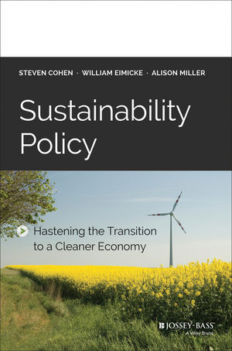
Today We Will Discuss:
1. What Is Sustainability Management?
2. Is It Feasible?
3. What Are The Prerequisites?
4. What Are The Challenges?
5. What Are The Fundamental Issues?
6. Why Do We Need Sustainability Public Policy?
7. What is The Role of the Government?
8. Policy Levers: The Federal Level
9. Policy Levers: The Regional Level
10. Policy Levers: The Local Level
11. Sustainability Measurement and Metrics
12. The Politics of Sustainability
13. The Future of Sustainability
Notes:
Edited numbers, added the before Government (capitalized)

Slide 3
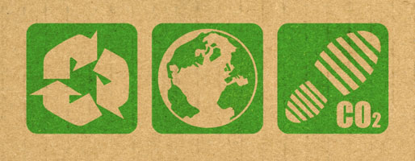
1. What is Sustainability Management?
What is “Sustainability”?:
  “Development that meets the needs of the present without compromising the ability of future generations to meet their own needs.” (1987 Brundtland Commission)
What is “Sustainability Management”?:
  Organizational management that results in sustainable development.
  Economic production and consumption that minimizes environmental impact and maximizes resource conservation and reuse.

Slide 4

1. What is Sustainability Management? (cont.)
The sustainability perspective is an effort to use management, design, engineering and public policy to make economic production and consumption efficient and effective – enabling continued productive use of our natural resources and long-term growth.
It is time to get over the outmoded ideological framework of the environmental era.
  There is no trade-off between environment and economic development.
Notes:
Bullet point 2) added “is” after “it”

Slide 5
1. What is Sustainability Management? (cont.)
Sustainability is simply the latest step in the past century's evolution of the field of organizational management.
  Traditional managers were concerned with financial, human resource, and information management, production processes, strategy and marketing.
Today's managers must also pay attention to the use and cost of natural resources, the cost of waste production and disposal and the environmental impact of organizational outputs and waste.
  These physical dimensions of sustainability can no longer be ignored.
  They are an increasing percentage of an organization's cost structure.
We need to invest resources in earth observation, technology, organizational capacity and public policy to build our capacity to produce enough food, energy, water, air and biological necessities required to maintain a healthy planet.
Notes:
Bullet point 3) edited require to required

Slide 6
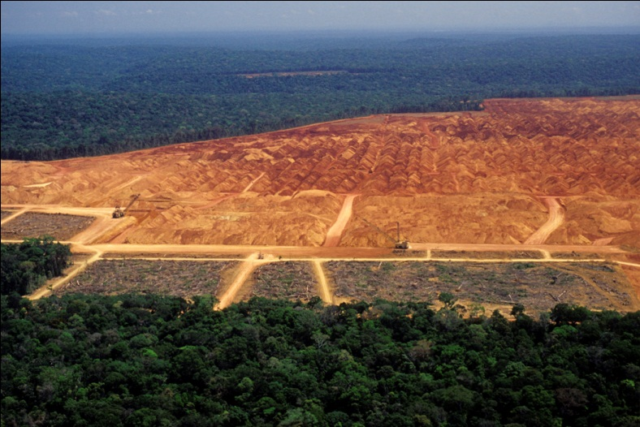
2. Is It Feasible? Can We Manage Our Way to Sustainability?
Is there enough capacity to produce the food, energy, water, air and biological necessities required to sustain human life while maintaining a healthy planet?
Managing the planet is beyond our current capacity.
  But the goal of the field of sustainability management is to develop the ability to do so.
We need sufficient:
  Natural resources
  Technology
  Management and
  Organizational capacity
Notes:
Bullet point 3) edited require to required

Slide 7

3. What are the Prerequisites of Sustainability?
We have the potential to begin a sustainable, green economic era if we meet the following prerequisites:
  Peace: we must reduce the destructive elements of competition between nations and people.
  Population and Poverty: ending poverty would end population growth and reduce the environmental stress caused by overpopulation.
Notes:
Bullet point 3) edited require to required

Slide 8
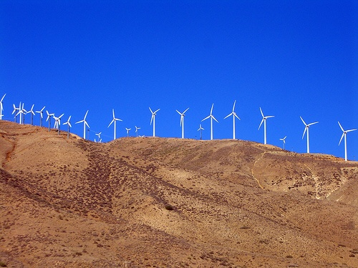
3. What are the Prerequisites of Sustainability? (cont.)
Energy: develop a renewable, non-fossil fuel-based energy economy in order to reduce damage to the ecosphere.
Ecological Footprint: learn how to reduce the damage we do to our environment.
  Most of the world’s population now lives in cities. This might help us preserve surrounding natural environments.

Slide 9
4. What are the Technical, Managerial, and Political Challenges of Sustainability?
We need new technologies for:
  Water: an increasingly rare resource that must be distributed, processed and used efficiently.
  Waste: we must learn to clean sewage and other waste, treating it as a reusable commodity instead of as a residue.
  Food: must be mass-produced while retaining the capacity for re-growth and regeneration.
  Energy: solar or nuclear energy.

Slide 10
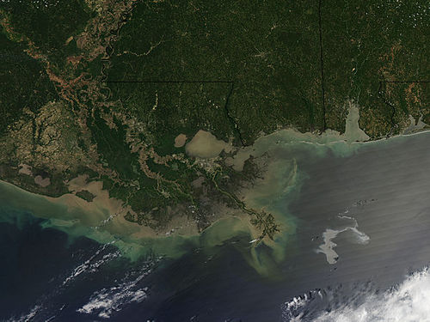
4. What are the Technical, Managerial, and Political Challenges of Sustainability? (cont.)
The implementation of new technology:
  Specific measurements of the planet’s conditions will help us identify problems and the success or failure of new solution-seeking technology.
    Current earth observation measures are insufficient.
  Public policy will be needed
  to ensure that sustainability
  technologies are put into use
  throughout the world.
    New technologies take time to adopt; incentives are needed to accelerate adoption.

Slide 11


4. What are the Technical, Managerial, and Political Challenges of Sustainability? (cont.)
Funding is necessary for the development of new technologies. But where will it come from?
There are many examples of successful government funded technologies that built private businesses:
  Internet
  Cell phones
  Laptop computers

Slide 12
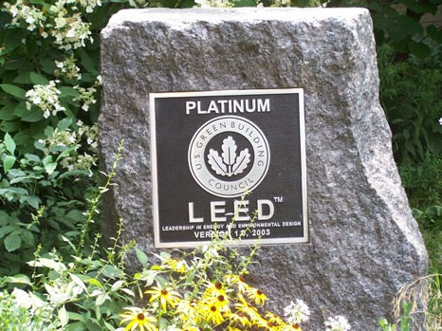
4. What are the Technical, Managerial, and Political Challenges of Sustainability? (cont.)
Adopting new technologies into human organizations will be a challenge.
  Many services and goods are built on non-sustainable technologies.
  Standard operating
  procedures are
  persistent and slow
  to change.

Slide 13

4. What are the Technical, Managerial, and Political Challenges of Sustainability? (cont.)
Requirements of sustainability management
in companies:
  Incentives to change behavior
  Resources to pay for incentives
  New thinking about resource use and waste:
    Integrating sustainability into strategy;
    Understanding integrated systems;
    Collaborative innovation with stakeholders;
    Valuing the long-term;
    Measurement and reporting.

Slide 14
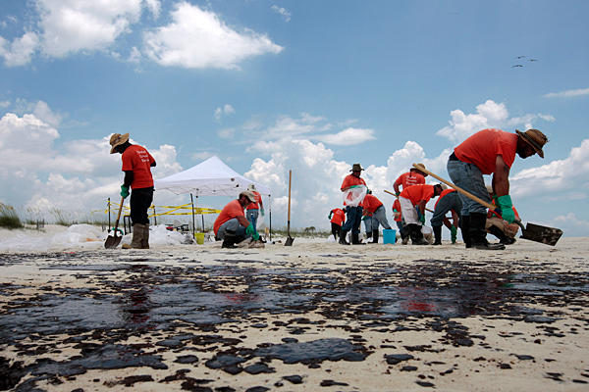
4. What are the Technical, Managerial, and Political Challenges of Sustainability? (Continued)
Policy is often made with short-term goals in mind. Sustainability requires long-term thinking.
There is a lot we do not know about solving sustainability issues – we must adopt an aggressive trial and error strategy.
  Politics often punishes uncertainty and makes it difficult to confess errors.
Measuring results and taking corrective action when mistakes are made is crucial.
  Though difficult to “spin.”

Slide 15
5. What are the Fundamental Issues of Sustainability?
The field of sustainability must include analysis of:
  Sustainable Manufacturing and Services Businesses
  Renewable Energy
  Sustainable Water
  Sustainable Food Supply
  Sustainable Cities
  A Sustainable Planet

Slide 16

6. Why Do We Need Sustainability Policy?
Sustainability management emerged to cope with the 21st century problems facing the global economy.
The development of a sustainable, renewable resource-based economy has become a necessity.
The private sector cannot make the transition from a waste-based economy to a renewable one by itself. This transition requires a public–private partnership.

Slide 17
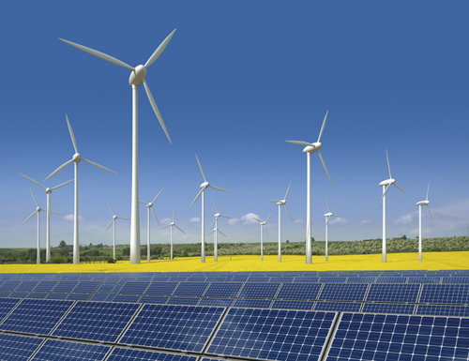
6. Why Do We Need Sustainability Policy? (cont.)
The public and private sectors play important and often complementary roles in the transition toward a sustainable economy.
But the private sector is limited and some goals are so massive, important and difficult that they require government leadership, resources and authority.
Only government has the capacity to take the lead toward a renewable economy.
Notes:
Bullet point 3) edited towards to toward

Slide 18

6. Why Do We Need Sustainability Policy? (cont.)
We do not know precisely how to develop a sustainable economy, but we are on the road to figuring it out.
Governments need to act aggressively through the tools at their disposal.
There are a variety of options at the national, state and local level.
  National policies can set broad standards.
  State policies can serve as forums for localities.
  Cities are leading the efforts in sustainability.
Notes:
Add in specific cities?

Slide 19

7. What is the role of government?
Role of the Government in Building a Sustainable Economy:
Funding Basic Science
  Measurement and research tasks are basic government functions; it must fund basic R&D for renewable energy, energy efficiency, storage, and other sustainable technologies.
Funding Infrastructure
  Government must fund the energy, communications, research, waste and water management infrastructure needed for the 21st century.
Providing Incentives for Private Investment
  Government can employ a number of market-based tools to support renewables.

Slide 20
7. What is the role of government? (cont.)
Setting and Enforcing Rules to Protect the Environment
  We need rules and regulation to provide incentives for organizations to innovate and protect our critical resources.
  Consistently, federal regulatory benefits outweigh the costs.
Developing Sustainability Metrics and Management
  We need agreed-to organizational sustainability indicators that everyone can use and understand.
  Government must play a role in measuring sustainability.
Transferring Technology to the Developing World
  Developing nations need incentives to use the new technologies instead of older ones that might get cheaper as they are discarded by the developed world.
Building Public-Private Partnerships
  We need to working with private organizations to ensure that the transition is well-managed in the real world.
Notes:
Bullet point 7) added – for the word well-managed

Slide 21
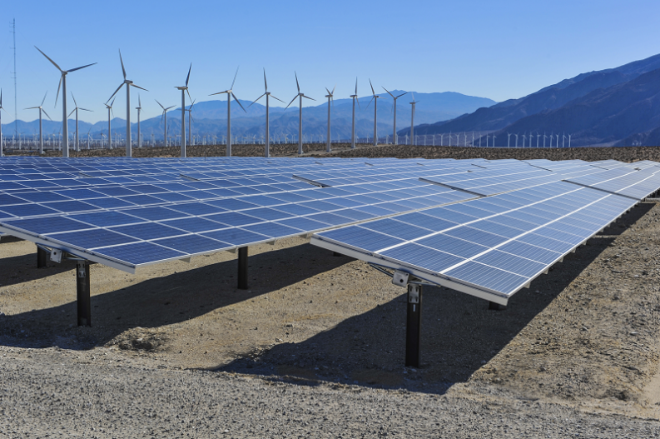
8. Policy Levers: The Federal Level
Public Investment and Spending
  The government can directly fund and invest in basic R&D.
Public Procurement
  The federal government can use its immense spending power to be a market mover when it comes to renewables.

Slide 22
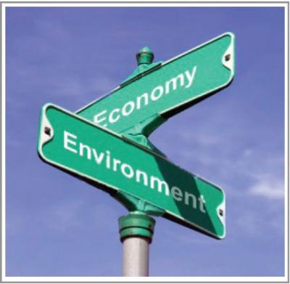
8. Policy Levers: The Federal Level (cont.)
Market Based Tools
  Using markets, prices, or other economic incentives to induce change.
Regulations and Standards
  Many environmental successes of the last fifty years are due to traditional regulatory policies, like the United States’ Clean Air Act, which is now being used to regulate climate change.
Infrastructure
  Federal governments must build the infrastructure of the 21st century. For example, high speed rail in China and the Eurostar in Europe are faster, more efficient, and cost effective modes of transportation.

Slide 23


9. Policy Levers: The Regional Level
Regulatory Tools and Standards
  Regional cap and trade systems
  Building Codes
  Feed-In Tariffs
Financial Tools and Mechanisms
  Green banks, which leverage private investment
  Tax credits, rebates and subsidies
Energy Policy
  Climate adaptation planning has grown over the past decade
  For example, in the United States 32 states have climate action plans

Slide 24

9. Policy Levers: The Local Level
Cities are important agents for sustainability due to their population size, environmental impact and direct service delivery role.
City-level initiatives have a high level of political support;
  Leaders understand that sustainability drives economic growth.
Many sustainability initiatives are more visible at the local level
  For example, Bikes, Green Infrastructure, Recycle Bins

Slide 25
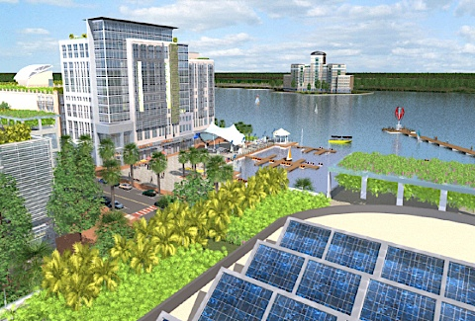
10. Policy Levers: The Local Level (cont.)
Local governments have greater control over key actions that affect sustainability directly: land-use zoning, transportation, natural resources management, buildings, waste and water services, etc.
Adopting sustainability has become central to urban vitality and making cities competitive globally.

Slide 26

10. Policy Levers: The Local Level (cont.)
Cities are working to build resilient, sustainable communities:
Energy – encouraging energy efficiency, conservation, renewable energy
Air Quality – reducing emissions from buildings/vehicles
Transportation – encouraging public transportation, active transport, electric vehicle infrastructure
Water and waste management – implementing green infrastructure, recycling, waste-to-energy
Community design and land use – investing in brownfield redevelopment, parks and green spaces
Notes:
Last bullet point: corrected to redevelopment

Slide 27

11. Sustainability Metrics
Sustainability does not yet have a clear and measurable definition – but it needs one in order to be integrated in routine decision-making.
Sustainability reporting by companies is growing, with measures such as the Global Reporting Initiative (GRI), or those developed by the Sustainability Accounting Standards Board (SASB).
But there are many challenges with reporting: most lack comparability, rigor, and independent audit.
The number of different measures often vary in scope and scale.
These are all voluntary efforts.

Slide 28

11. Sustainability Metrics (cont.)
We need a generally accepted set of definitions and indicators for measuring sustainability that everyone within both private corporations and public sector organizations can understand and utilize.
The public sector has a role – mandatory reporting is growing across the globe.
  France is a leader in mandatory sustainability reporting.
  Many other nations are beginning to implement reporting standards and laws.
  The U.S. can start with a national commission on sustainability metrics in order to develop a national set of standards.
Notes:
Deleted additional spaces

Slide 29


12. The Politics of Sustainability
It is difficult to understand why safe air, water, and land should be political controversial.
In the United States, the increasing partisanship in Washington has made Congress more and more unproductive.
  Some conservatives argue that government is too ignorant of business practices to regulate them.
However, regulations have both costs and benefits and a clean environment has more economic benefits than costs.

Slide 30
12. The Politics of Sustainability (cont.)
The politics of sustainability will have an ideological component
  But the facts of global interconnectivity are increasingly hardwired into our culture and values.
The importance of environmental quality and sustainability is an inescapable part of our shared understanding of how the world works.
Preserving the resources needed to ensure sustenance is a requirement of all political processes and governing regimes.

Slide 31

13. The Future of Sustainability (cont.)
Moving towards a cleaner economy requires:
  An engaged citizen base.
  Flexible policy design.
  Accurate science and measurement.
Sustainability requires all levels of society – government, the private sector, and citizen participation – in order to succeed and move forward.

Slide 32
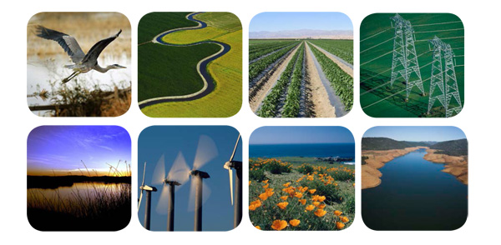
13. The Future of Sustainability (cont.)
The key question is how do we get from here to there? How do we make the transition to a renewable, sustainable economy?
Trying to make people feel guilty for their consumption is a losing strategy.
A positive vision of a sustainable lifestyle includes entertainment, education, creativity, exciting ideas, social interactions, healthy and flavorful food and drink, exploration, fitness and fun.
While we need to pay attention to the environmental impact of our lifestyle, we need to understand that it will take a long time to develop sustainable consumption and economic growth.

Slide 33

13. The Future of Sustainability (cont.)
The transition to sustainability will require:
Technologies for renewable production
Public policies and organizational practice that use knowledge of environmental impact.
A change in culture, norms and values about consumption and lifestyle.
Technological change results in economic change that in turn causes social change; social change creates a context for political change.

