Slide 1
Growth, Innovation and Upgrading
“Constructing a Prosperous and Sustainable Post-Conflict Society in Colombia”
Professor Arvid Lukauskas
Columbia University
29 April 2015

Slide 2
Agenda
Sources of Growth
Role of Productivity
Innovation and Upgrading
Government’s Role
Industrial Policy
Clustering
Case Studies of Upgrading

Slide 4
What Generates Economic Growth?
Capital accumulation
All new investments in land and physical equipment
Accumulation of human capital
Higher skills through improved education and health
Population growth
Leads to an eventual increase in the labor force
Improvements in productivity

Slide 5
What is Total Factor Productivity (TFP)?
TFP explains the growth in national output that cannot be attributed to increases in the level or quality of measured inputs
TFP has two components:
Technological progress in best practice (e.g., in producing Good 1)
Change in technological efficiency (movement toward best practice)
Good 1
1
PPF
2
Good2

Slide 6
What are the Sources of Productivity Growth?
→ Process innovation
(e.g., reengineering of shop floors)
→ Management innovation
(e.g., “total quality management”)
→ Externalities
(e.g., knowledge spillovers)
→ Scale effects
(e.g., “learning by doing” and “matching”)
Technological Change
R&D
Trade
FDI
Sub-contracting & Licensing
Notes:
6

Slide 7
TFP, Not Factor Accumulation, Drives Growth
Accumulating physical capital and human capital is necessary but not sufficient
Differences in TFP largely account for differences in the rate of economic growth across countries
In faster growing countries, TFP accounts for more than half of economic growth
Sustained growth is characterized by continuous industrial and technological upgrading

Slide 8
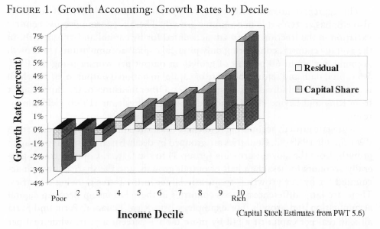
Source: Easterly and Levine (2001)

Slide 10
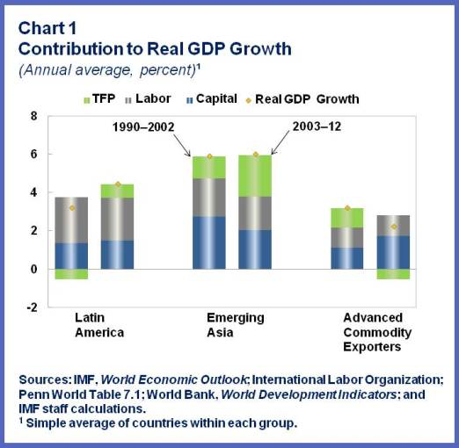

Slide 11
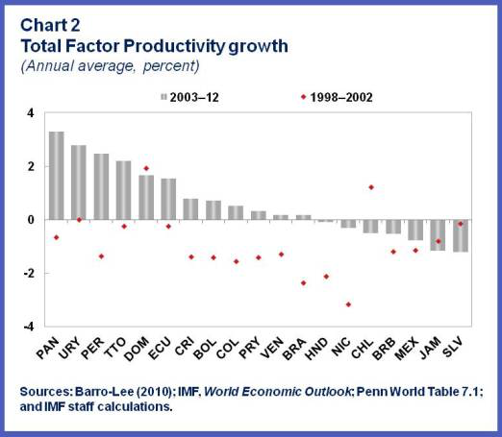

Slide 12
Industrial Upgrading
More countries are vying for the same goods and services markets
Lower costs and better communication enable new entrants
Quick diffusion of technology and an ever shorter product life cycle
Intense competition for investment funds
This creates the need to move into new sectors
Notes:
Upgrading seems to take place when firms face competitive pressure and upgrade to survive

Slide 13
What is Upgrading?
Upgrading is moving up the value-added ladder
=> Primary products
=> Labor-intensive activities
=> More integrated, capital-intensive manufacturing
=> Most profitable skill- and knowledge-intensive activities

Slide 14
Upgrading and Competitiveness
A nation’s long-term growth requires firms to:
Relentlessly improve productivity in existing industries
Acquire the necessary capabilities to compete in increasingly sophisticated industry segments
Productivity is generally high in this segments
Develop the capability to compete in entirely new, sophisticated industries
Michael Porter

Slide 16
What is Innovation?
Innovation is developing products, processes, designs, means of organization or delivery that are completely new or new for the nations or firms that use it

Slide 17
Sources of Innovation
Firm research and development (R&D)
Contract R&D from government, university, or private labs
Sub-contracting and licensing
Competitors (via ideas, personnel, products)
Customers and suppliers
Technical literature and university research
Consultants and new hires

Slide 18
Sources of Innovation and Use Map
Modes of Acquisition or Transfer
Purchase of:
-capital goods & components,
-technology licenses
Copying and reverse engineering
Outside technical assistance services
Outside technical literature
Education and training outside country
Investments by established companies
Immigration of persons with technology and skills
People knowledge sharing networks
Information technology enabled networks for sharing knowledge
Modes of Transfer of Locally Created Knowledge
Patents and Licensing
Technology consultancy services
Education and Training of students and managers
Business incubator and spin-offs or creation new technology based firms
Movement of persons from research institutes and universities into business and social sectors
Information sharing networks
Users of Knowledge
1. Acquiring Knowledge from Abroad
Firms
Agriculture
Industry
Services
Government
Administration and management
Development planning and implementation
4. Disseminating
Knowledge:
Market
Growth of more efficient firms
Specialized suppliers
Engineering and consulting firms
Informal Networks
People networks
Informal technology enabled networks
Specialized organizations
Information Centers
Productivity Centers
Extension Organizations
Technology Infrastructure
Metrology
Standards and Quality Control
2. Acquiring
Knowledge from elsewhere in country
Public Institutions
Education system
Health system
Infrastructure service institutions
Courts
Security
3. Creating New Knowledge in Country:
Public Research Institutes
Universities and Training Institutes
Firms
Individuals
Social organizations
Ngos
Communities
Cooperatives
People
Key Enablers: Economic and Institutional Regime--Information and Communications Infrastructure-Education
Dahlman 2011

Slide 19
Innovation in Emerging Markets
Emerging market countries can get high returns inexpensively from tapping into existing knowledge
In the public domain (e.g., technical literature)
Purchased through formal means (e.g., licensing)
Acquired by copying and reverse engineering

Slide 20
Innovation in Emerging Markets
Emerging markets also need to invest in their own capability to acquire, use, and create knowledge
Know what to look for, assess its relevance to the domestic context, adapt and improve it
Eventually do basic R&D in order to be part of global research networks

Slide 21
Barriers to Innovation in Emerging Markets
Institutional Structure
Inadequate property rights
Opposition from vested interests
Lack of competition
Ideology
Large informal sector and small firm size
Insufficient human capital (education and health)
Poor infrastructure

Slide 23
State Must Play Some Role
The state must take an active role in improving productivity and upgrading
Few if any countries have succeeded with largely laissez-faire policies
How extensively and in which ways should the state intervene?
The debate often comes down to whether the state seeks to facilitate or defy comparative advantage

Slide 24
State as Facilitator
Help the private sector exploit the nation’s comparative advantage
Entering into a sector too early results in:
Inefficient use of scarce resources
Market distortions
Inability to accumulate factor surpluses necessary for the process of upgrading
Import substitution industrialization showed the failure of this approach
States that have successfully upgraded did so in a gradual process in line with their changing factor endowments

Slide 25
State as Transformer
Transform economic structure by defying comparative advantage
Countries acquire industry-specific technical capabilities through actual production experiences
Accumulating capital and human capital generally will not enable a country to become proficient in new areas
Target sectors with desirable characteristics or those where comparative advantage “ought to emerge”
These are sectors where the private market underinvests

Slide 26
Industrial Policy Options
Most economists are skeptical of transformer approach
Few governments have:
The institutional capacity of the most successful East Asian cases
A political context that allows decisions to be made on the basis of economic criteria
Governments should focus on:
Providing functional industrial policies
Strengthening private-to-private networks at the regional, national, and international level

Slide 27
1. Functional Industrial Policy
Alleviate market failures
Implement policies that benefit all industrial sectors (though the impact may be asymmetrical)
Examples of such policies are:
Supplying physical, social and technology infrastructure
Creating public research and training institutes

Slide 28
Correcting Market Failures
Market failures are present in all countries
They are more prevalent and severe in developing and emerging market countries
Two of the most important are:
Information externalities
Coordination problems

Slide 29
Information Externalities
Knowledge generated by research and development often has a public goods character:
Actors who have not contributed to the creation of knowledge may gain access to it because of spillovers
Consequently, knowledge may be undersupplied to the detriment of society
The government may address this by providing R&D subsidies

Slide 30
Coordination Problems
Infrastructure is undersupplied by private markets
Physical: transportation and communication systems
Social: education and health systems
Legal: property rights
Development requires simultaneous improvements in all these areas
The state can coordinate the provision of these goods

Slide 31
2. Develop Networks
Promote exports
Bring national firms into contact with international best practice
Insert firms into supply chains
Enter into public-private partnerships, especially in support of clusters
Support collaborative R&D
Encourage foreign direct investment

Slide 32
Clusters

Slide 33
Clustering
Many efforts to foster networks focus on clustering
Clustering is the sectoral and spatial concentration of firms
A dominant feature of developed country and increasingly emerging and developing country industry
Often critical in the incipient stages of industrialization

Slide 34
Agglomeration Economies
Spatially- and sectorally-concentrated increasing returns
Sources of agglomeration economies
Access to suppliers of specialized inputs and services
Labor market pooling
Spillover of knowledge
Threshold barriers are high – difficult to get started in a new industry or location
Coordination failure

Slide 35
Government’s Role
Increase confidence of investors to:
Envision future benefits by signaling a commitment to growth
Have secure property rights
Have access to credit
Internalize any external benefits that entrants create
Large developers
Subsidies
Temporary support through an industrial policy

Slide 36
Industrial Policy for Clusters
Construct a new urban infrastructure
Foster advanced and specialized factor development
Develop a science and technology policy
Promote foreign direct investment and exports
Undertake regulatory reform
Collect and disseminate economic information

Slide 37
Fostering Clusters and Networks
Traditional approach: foster clusters in a top-down fashion, focusing on a single cluster
Recent approach: a collaborative process at the regional level
Involves governments as well as firms, universities, and other actors
Several clusters may be promoted simultaneously
The most successful clusters feature substantial cooperation among firms and other actors

Slide 38
Risks of Clustering
Exacerbate regional and income inequality
May damage other regions if not complementary
Possible negative externalities
Congestion
Pollution
Strain on government services
High levels of rent seeking, particularly due to efforts to internalize externalities

Slide 39
National Case Studies of Upgrading
Building Competitiveness

Slide 40
Upgrading to Sustain Growth
Costa Rica
Develop as an exporter of knowledge and skill-intensive products, especially electronics, by attracting FDI to jump start the process (the “Intel strategy”)
Malaysia
Move into high-tech sectors such as nanotechnology in an effort to avoid getting stuck in the middle

Slide 41
Costa Rica
In the mid 1990s, Costa Rica’s economy economy was primarily based on agriculture, textile and tourism
By Latin American standards, the country’s physical and social infrastructure was quite developed
The country’s chief virtue was its stable political system and well functioning institutions

Slide 42
Objective
Goal was to move up the value-added chain:
Shift from labor-intensive and commodity agriculture to technology- and knowledge-based activities
To reach this goal, the Figueres administration sought to create an “electronics and information technology cluster” capable of competing globally

Slide 43
Key Elements of the Strategy
Established an economic development agency
Modeled after Singapore’s Economic Development Board
Created an export processing zone
Provided incentives to companies exporting non-traditional products
Designed focused training programs
Developed infrastructure to facilitate international trade
Implemented a social investment program to prepare the population for global competition

Slide 44
Courting
Proactively marketed Costa Rica as a desirable location for Intel to build an assembly and testing plant
Believed Intel’s investment would signal credibility
The chief elements of the approach included:
Improving existing education, transportation, energy and tax structures
Streamlining bureaucratic processes and procedures
Personal commitment of the president

Slide 45
Results
Intel invested $770 million
Costa Rica became a key operation accounting for about one quarter of all its sales
Intel employed 2,900 workers and created about 2,000 indirect jobs
The “signaling” effect worked:
FDI in high tech sectors increased
Included diverse sectors such as medicine and call centers
Exports diversified dramatically, with non-traditional exports comprising 80% of the total by 2003
Local supplier of services but not inputs flourished

Slide 46
Lessons Learned
Leverage the strategic project as a “flagship” investment
Stay abreast of investor requirements and continually adapt the investment climate
Coordinate support among existing investors and the highest levels of government
Develop a strategy to establish service and supply networks for priority sectors

Slide 47
Malaysia
Malaysia experienced rapid growth – nearly 4 percent annual real growth in GDP/capita
FDI used to create domestic industries in more advanced sectors such as electronics
Part of complex supply chains spanning Southeast Asia
The country was afraid of getting “stuck in the middle”
Unable to compete at the low end with China and emerging Southeast Asian countries
Unable to move into the higher end with Singapore or Korea

Slide 48
Vision 2020
Created a national plan to become a developed country by 2020
Improve physical infrastructure
Provide better and faster information technology
Enhance education to foster a knowledge-based economy
Strengthen the banking sector
Improve regulation
Increase the efficiency and quality of public services, especially reduce corruption
Alleviate poverty
Encouraged the development of newer industries, such as biotechnology and nanotechnology

Slide 49
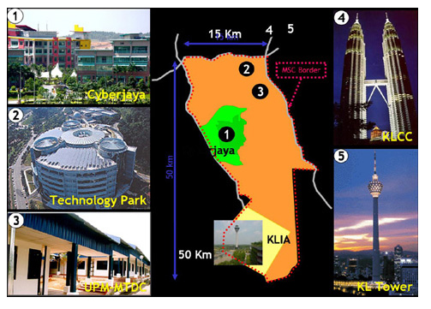
Turn Malaysia into the information technology hub of Asia Creation, distribution and integration of products and services Government committed $12 billion to build infrastructure
Multimedia Super Corridor

Slide 50
Incentives to Foreign Firms
Exemption from local ownership rules
Unlimited foreign workers
10 years tax holiday or 100% investment tax allowance
Duty free imports on telecomm equipment
Special telecommunication rates
Secure intellectual property rights

Slide 51
Multimedia Development Corp
Established to promote the corridor
Marketer
One-stop shop for investing firms
Facilitate relations between domestic and foreign firms
Advisor to the government
Micro-manager approach
Preference granted to “web-shapers”

Slide 52
Challenges
Limited experience in IT
Poor intellectual property laws
Insufficient number of workers with the requisite skills
Perception that benefits to most Malays are small
Cross border issues concerning cyberlaws, censorship and standards
Competing clusters in other Asian cities

Slide 53
Mixed Results
Banks did not fund IT enterprises
Limited entrepreneurship due to lack of a risk-taking culture
MDC unsuccessful in attracting cutting-edge firms
MDC shifts focus to labor-intensive IT activities at low end of value-added chain
Data processing and customer service centers
Generated lots of jobs

Slide 54
Lessons Learned
Need realistic ambitions
Government capacity is critical
Micro-managing does not work
Need a match of worker skills and investment type
Or a plan to develop adequately
Intellectual property is key

