Slide 1
1871
A grand experiment …
… that has gone really really well.

Slide 2
In fair Chicago, where we lay our scene
History of Chicago’s tech community: Orbitz, GrubHub, Groupon
The Merchandise Mart: Motorola, Braintree, Yelp
Massive braindrain to the coasts (Netscape, Paypal, others)
World class city with a global economy and a growing tech sector
33 Fortune 500 headquarters
No other single industry makes up more than 14% of the economy
18,000 foreign-based companies located in Chicago
Over 40,000 tech jobs in Chicago (+ 15,000 since 2011)
Needed a galvanizing force

Slide 4
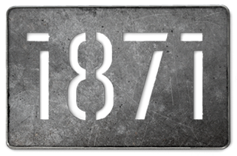
The 1871 Experiment
Private Sector
State of Illinois
Tech Community
City of Chicago
CEC
Universities
VC
Individual Business Leaders

Slide 5
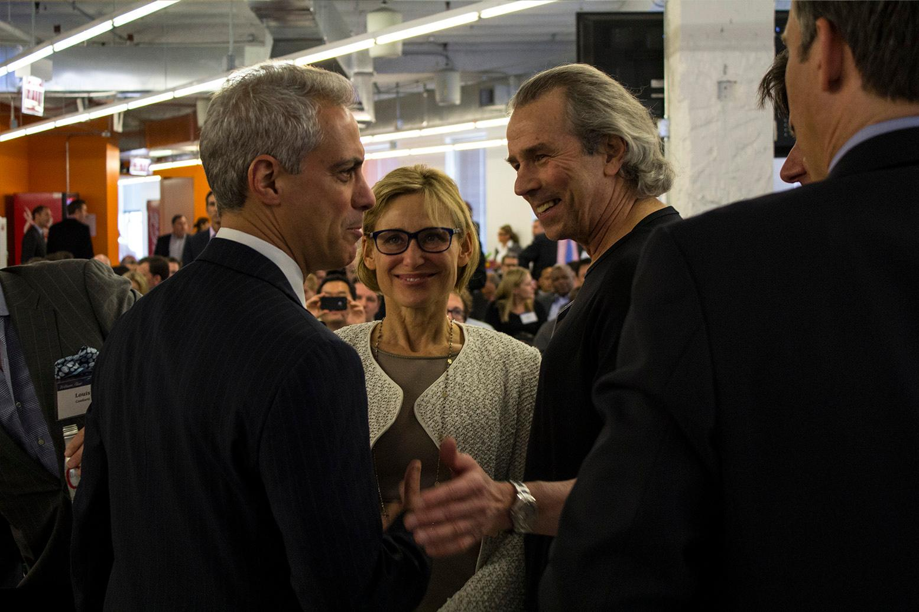

Slide 6
The First Question
Can you build a home for the technology community in Chicago?

Slide 7
The First Answer
Yes!
1871 is a 75,000 sq. ft facility home to more than 325 early-stage, high-growth digital startups. It is the headquarters of nationally recognized accelerators, a number of industry-specific incubators, several emerging tech talent schools, and the state's leading technology advocate, the Illinois Science and Technology Coalition.

Slide 8
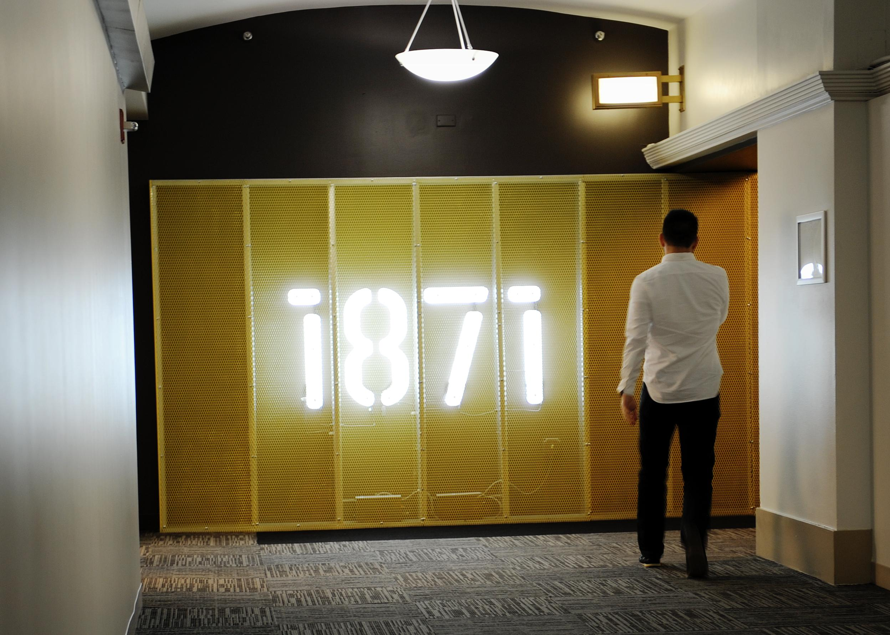

Slide 9
The Second Question
Can that home for the technology community produce opportunities that are far greater than what might have been produced without that place?

Slide 10
The Second Answer
Yes!
350 companies
750 people
8 Universities
10 VCs
570 events
6000 hours one-on-one mentoring
250 workshops

Slide 11
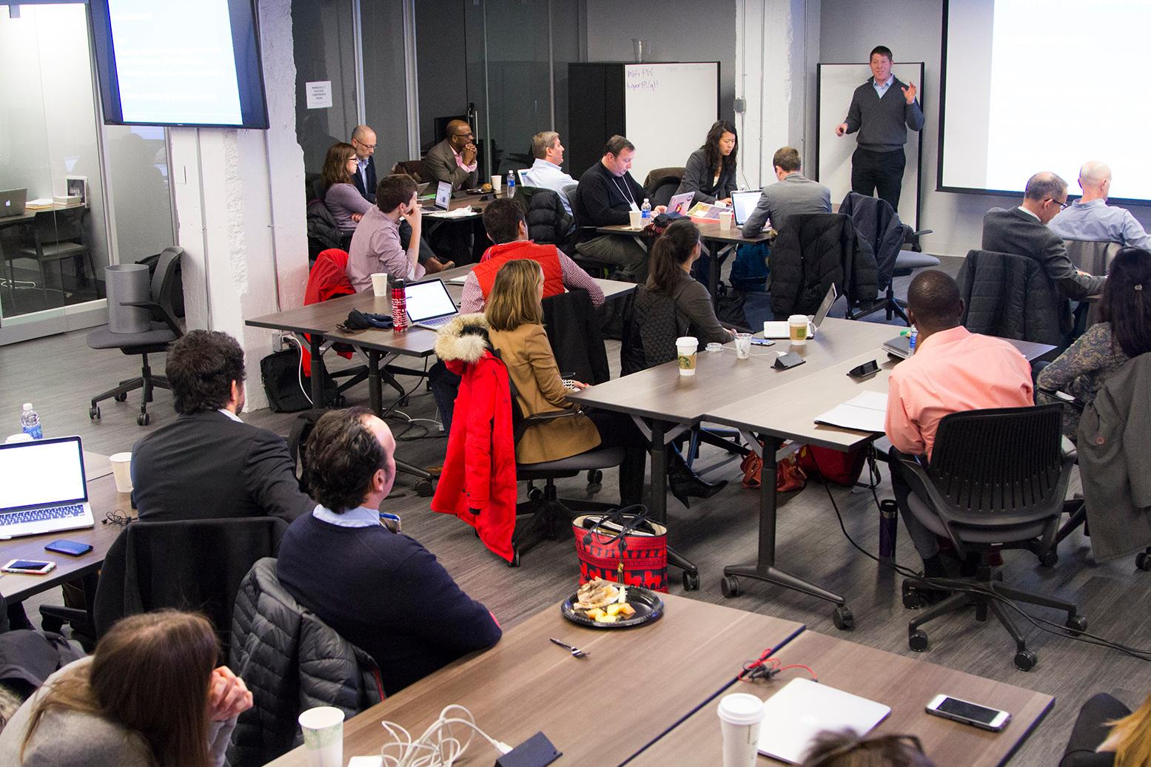

Slide 12
The Third Question
Can those opportunities produce a lasting, substantive effect on the community that will improve the lives of everyone in the region?

Slide 13
The Third Answer
We think so!
This question is why we come to work every day.

Slide 14
Progress
 | May 2, 2012 | January 2014 | Today
Sq. Ft. | 50,000 | 50,000 | 75,000
Schools | 1 | 1 | 8
VCs | 2 | 4 | 10
Incubators | 1 | 2 | 9
Companies | 100 | 250 | 350
People | 450 | 600 | 750
Traffic | 500 | 800 | 1400

Slide 15
We do three main things
Helping startups grow and succeed.
First and primary purpose. That’s what we pretty much do all day long.
Dealing with the inbound.
Everyone has an “1871 plan.” We are in the business of finding good opportunities.
Taking 1871 outside of these walls.
Helping cement the reputation of 1871 as Chicago’s digital hub and raise the fortunes of the entire community.

Slide 16
Ways We Meet Our Goals
We have established some “best practices” and other ideas that guide our thinking in how we spend our day to day efforts.
All of these goals are focused on our underlying goal – to create jobs and economic opportunity in the community.

Slide 17
1. Build a critical mass
Over 350 companies and over 750 individuals from those companies.
The average size of the company grows as they move through the space
New spaces built to accommodate companies as they grow
Leading vertical: Education

Slide 18
2. Build an ecosystem
Schools
Now have eight different coding or design schools
Universities
5 leading Illinois Universities
Northwestern, University of Chicago, IIT, University of Illinois, Loyola
Incubators-Food, Real Estate, Veterans, Women, Bitcoin, Education (*2), Impact Companies, International
Venture Capital Firms and Angel Networks
Companies- 350 member companies
Individuals- 350 mentors
Ecosystem becomes the Driver of the Ecosystem:
At a certain point, the ecosystem begins to grow and create opportunities without direct intervention

Slide 19
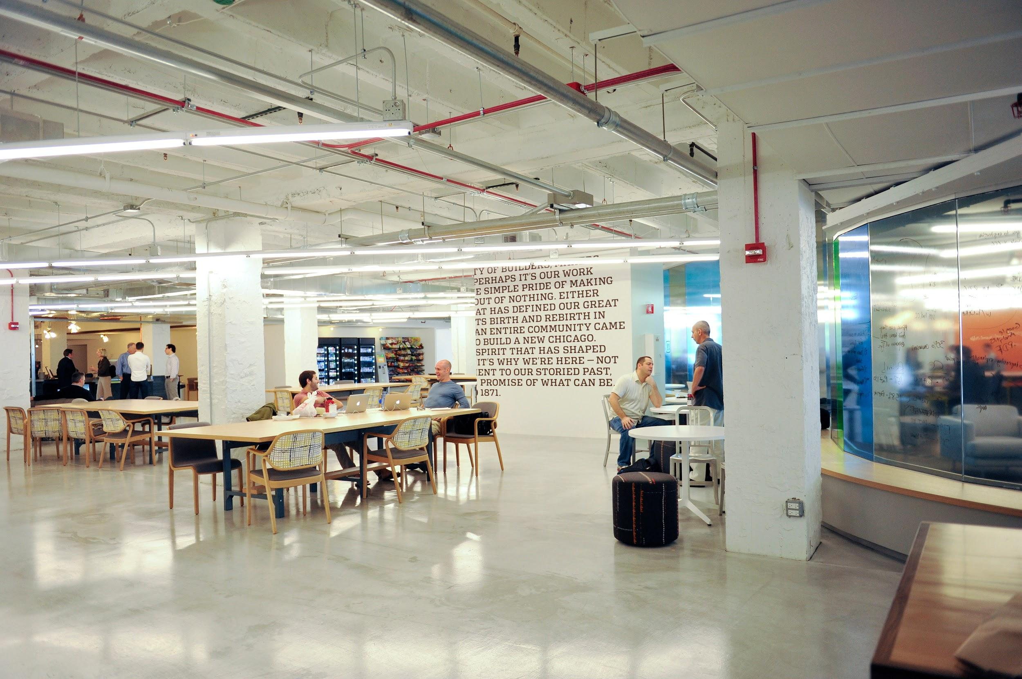

Slide 20
3. Focus on verticals
Presently we have nine incubators
Food, Real Estate, Veterans, Women, Bitcoin, Education (*2), Impact Companies, International
Our way of staying competitive in the marketplace

Slide 21
4. Embrace the sharing economy
To be successful in this space, it’s imperative that the values of the shared economy are emphasized.
South Classroom: Starter League, Designation
North Classroom: The Bunker, Fullbridge, Sales for Starters
2.03: The Startup Institute, and DVX Labs, ACLTC, Startup Leadership Program, Press Events, etc.

Slide 22
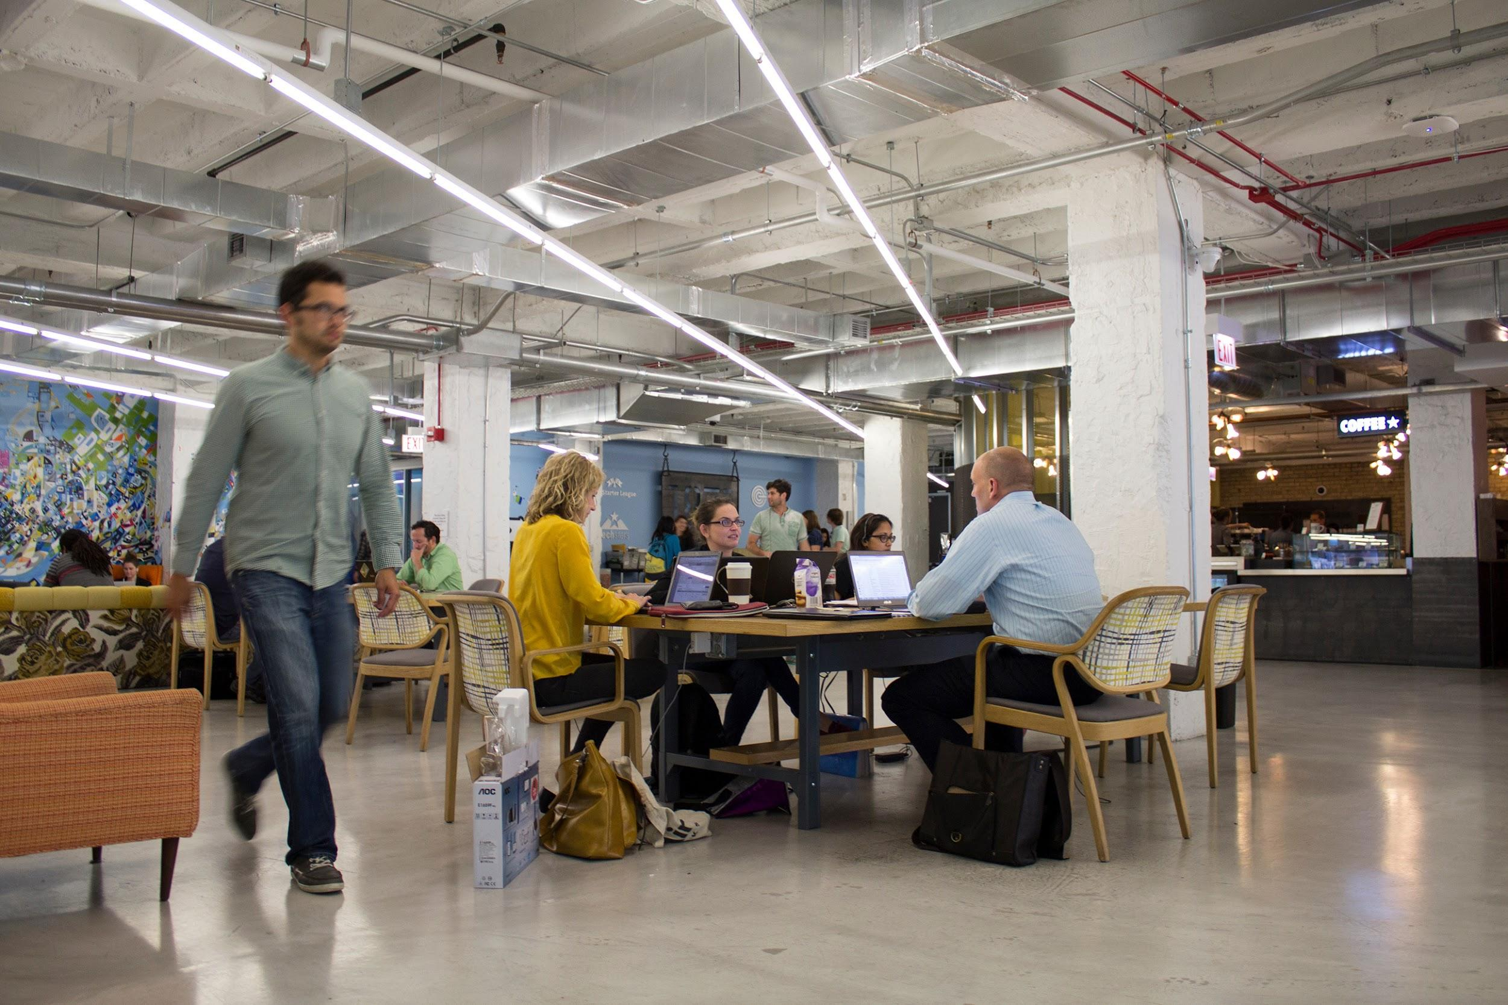

Slide 23
5. We are international
Exchange agreements – London, Tel Aviv, Toronto, Mexico City
Visiting cohorts – Turkey, Colombia, Israel
Chicago is the premiere launching pad for businesses trying to penetrate the U.S. Market
Strategic Partners – Sente, TechBridge

Slide 24
6. Engage corporations
Corporations are as essential for the success of 1871 as startups
Corporations have flexibility to invest or pilot; much more
Innovation Days: corporate partners send employees to talk with curated list of startups that could help make direct improvements to specific aspects of the corporation

Slide 25
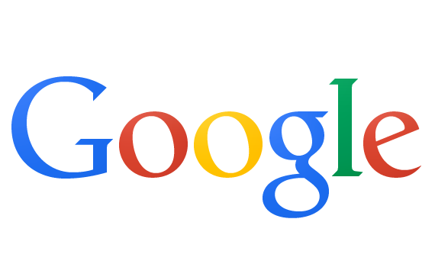
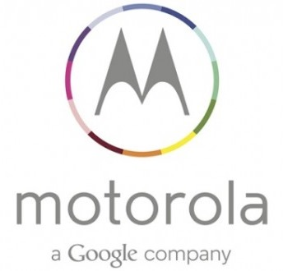
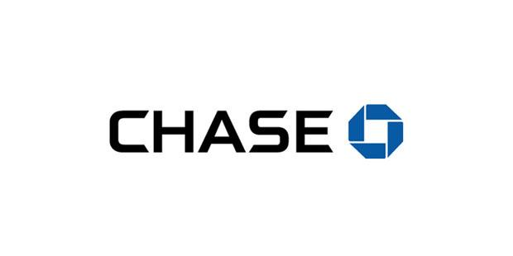
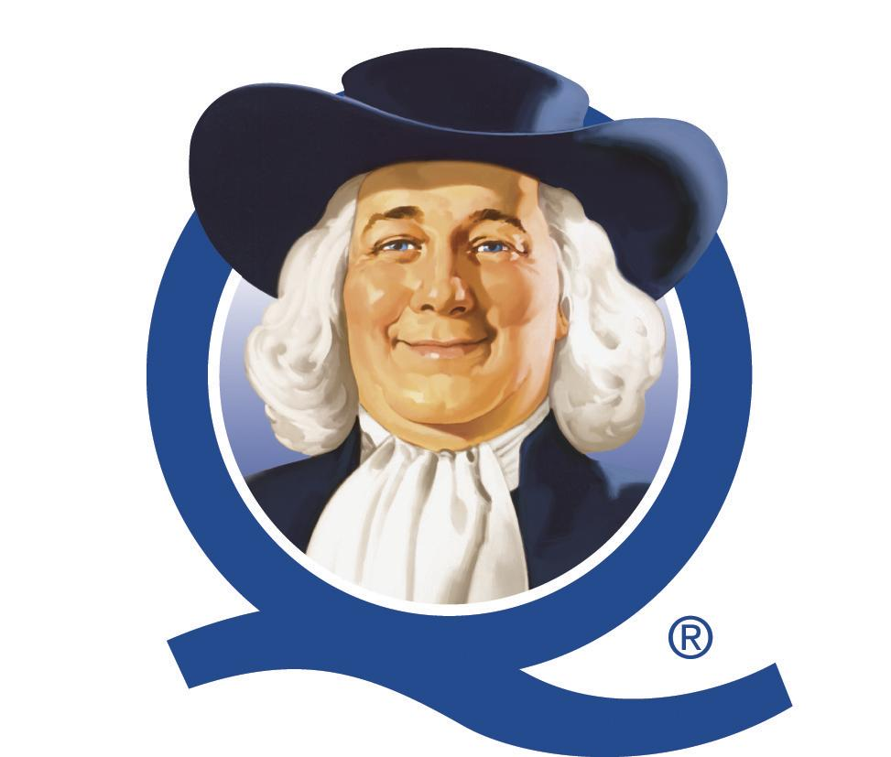
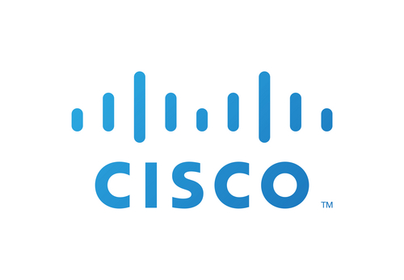
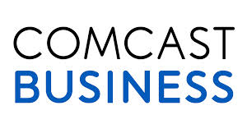
Some of Our Sponsors

Slide 26
7. Communicate
30,000 Twitter followers and over 6,000 Facebook followers
Weekly newsletter to 25,000 recipients and an internal community newsletter as well.
Plus we have a blog, a relationship with every reporter in town, and several communications people

Slide 27
8. Embrace the network effect
Interaction with alumni companies as mentors, partners, or potential collaborators
Google for Entrepreneurs network
1871 Companies can participate in GFE Demo Day
Reciprocal agreements with other GFE centers nationwide
Access to Google Cloud Platform
Google led workshops at 1871

Slide 28
9. Focus on education
We spend $1 million on programming every year.
250 workshops and over 5,000 hours of one-on-one membership.
Every aspect of the business process is covered.
PRIMARY CHALLENGE: Making sure the right people are at the right meetings.

Slide 29
10. Embrace diversity
We are committed to making strides in increasing access and educational opportunities to underrepresented groups within the tech community
More than 25% of our members come from a diverse background
CODE2040 Entrepreneur in Residence- powered by Google
The Bunker- Veteran accelerator
WiSTEM to roll out in the fall of 2015
Working with Illinois Hispanic Chamber of Commerce, Chicago Urban League among others to identify potential members

Slide 30
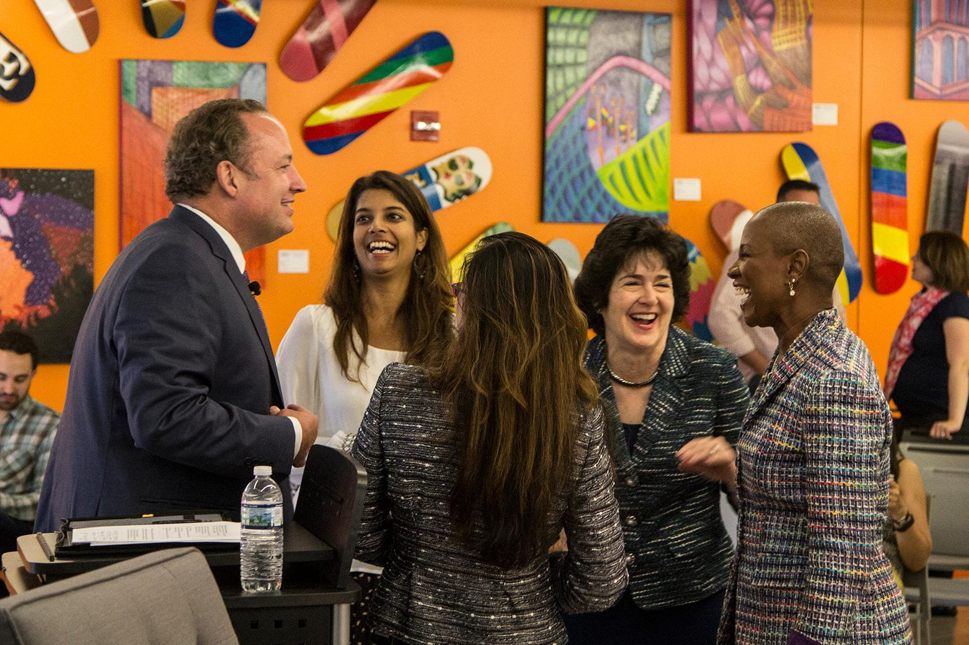

Slide 31
11. Making an Impact
Our goal at 1871 is to support companies that are not just focused raising revenue, but also on making a positive impact on the community.
Impact Engine
invests in for-profit businesses addressing the world’s greatest social and environmental challenges
Question on membership application

Slide 32
1871 is not a location
it is part of the business model for everyone here

Slide 33
Example #1 – 640 LABS
Exited in sale to Monsanto
company continues to grow in Chicago.

Slide 34
Example #2 – Package Zen
Just completed TechStars Chicago; raising first round of funding
Closed Memphis Grizzlies and FedEx Forum as a client.

Slide 35
Example #3 – Anyone Can Learn to Code
Now on their fifth cohort in 1871
Have trained nearly 50 career changers in coding.

Slide 36
What does the future hold?
This is an extremely competitive space.
Every day additional entities seek to compete with 1871.
We are going to continue to focus on the various initiatives we’ve outlined above
We are going to continue innovating and adding to our initiatives
Very little sleep

Slide 37
Why is this important?
Technology is the future of everything.
Every industry will be affected, will grow, will change because of technology.
In terms of having a lasting and sustainable impact on Chicago, this is the best.
“Modern mining”

Slide 38
Questions?

